Slide 1
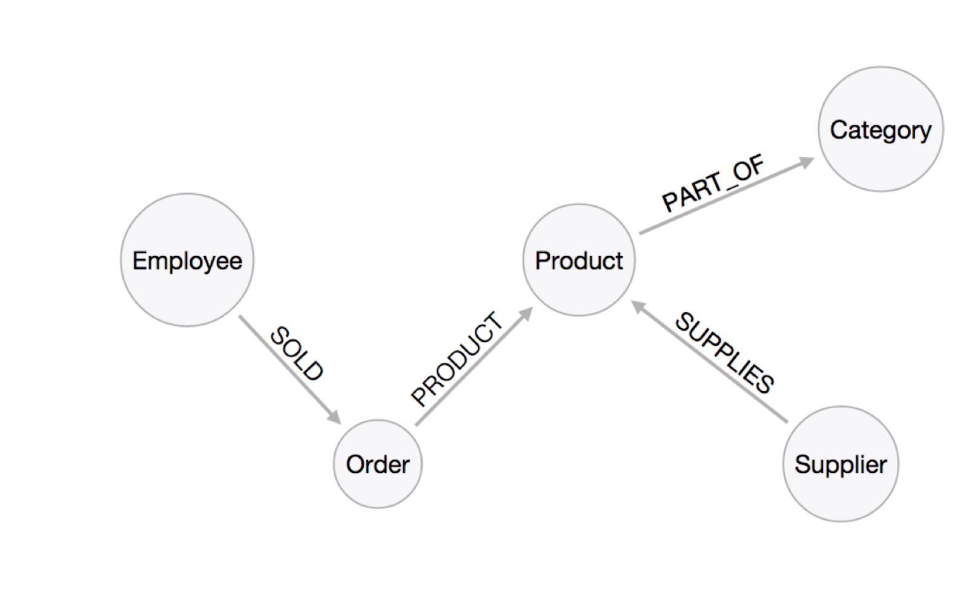
Territory
PART_OF
PART_OF
Region
SHIPS
BUYS
Shipper
CONTAINS
Customer Demographic
Customer

